Slide 1

Linux Socket Programming
by
Ravi Kishore K

Slide 2

Telephone Communication
To communicate with someone using a telephone
  you must pick up the handset,
  dial the other party's telephone number,
  and wait for them to answer.
While you speak to that other party, there are two endpoints of communication established:
  Your telephone, at your location
  The remote party's telephone, at his location
As long as both of you communicate, there are two endpoints involved, with a line of communication in between them

Slide 3
Network application
Network application has follows
An endpoint(telephone) for communication must be created on both ends
An address(phone no) is assigned to both ends to distinguish them from the rest of the network
One of the end points(caller) initiate a connection to the other
The other end(receiver) point waits for the communication to start
Once the connection has been made, data is exchanged(talk)
Once the data has been exchanged the end points are closed(hang up)

Slide 4
Anonymous Calls
In practice, one of the two sockets in a connection will have no address.
For a remote socket to be contacted, it must have an address to identify it.
However, the local socket that is ''placing the call" can be anonymous.
The connection that becomes established has one remote socket with an address and another socket without an address.
Local Socket
(Can be Anonymous)
Remote Socket
(Must have Address)
Internet

Slide 5
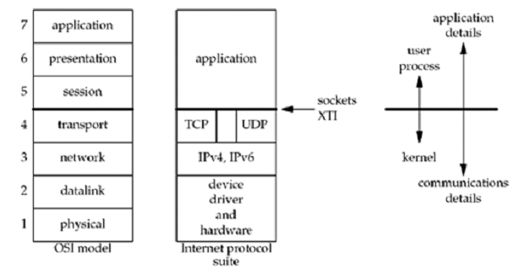
Sockets in TCP/IP Layers

